Slide 1

Bootcamp
Dibimbing.id
Career and Portfolio

Slide 2
Table of Contents
Problem with DS Job Landscape
What do Recruiters Seek?
DS Projects

Slide 3
Problem with Current DS Career World:
Non-specific:
Sometimes different job titles are doing the same job description (example: Business Intelligence Analyst in company A and Data Scientist in company B is tasked with creating machine learning model)
Sometimes the same job title are doing different job description (example: in company A, Data Scientist creates deep learning models, but in company B, Data Scientist deals with creating automated reports)

Slide 4
How to Mitigate?
Option 1: Go to Tech Company, especially mature startups. Their data roles are more specialized:
Data Scientist: creates machine learning / deep learning models (Python: must have, SQL: good to have)
Data Analyst: perform real-time analysis, and advanced Querying (SQL: must have, Python/R: good to have)
Data Engineer: deals with data and cloud infrastructure, model deployment, etc
Cons: sometimes high barrier to entry

Slide 5
How to Mitigate?
Option 2: Be versatile, and be a full-stack data person, and apply in companies that are starting to develop their data team.
Cons (or sometimes this is a Pros for some people): not clear specialization, and less developed infrastructure.

Slide 6
How to Mitigate?
Option 3: Apply for an analyst role in your domain. Then use Data Science inside your work. Use data cleaning, exploration, and machine learning principles as you see fit. Work for 6 months - 1 year. (Alternatively, apply for database management system roles)
Use that as ‘experience’ and ‘portfolio’, then you can try and become a Data Scientist/Analyst in another company.

Slide 7
Data Science Job Opportunities
Right now, as the world recovers from the pandemic and wants to accelerate economic recovery, Data Science jobs are in demand
Why?
Can we still use old assumptions in this new normal? What should be our ‘base’ assumptions / logic in the new world? We have to gain insights with data.

Slide 8
What do Recruiters Seek?
In tech companies, especially those with mature system already in place, usually their interview process is more standardized too.
Step 1: Coding Test (SQL + Python)
Step 2: If passed, proceed to HR Interview
Step 3: If passed, proceed to User Interview (can have multiple rounds)

Slide 9
What do Recruiters Seek?
However, generally speaking, you need to have this to succeed:
Convincing communication skills
Good project that is well documented, uploaded to github, and can be explained BOTH in DETAIL and in GENERAL
Understanding of basic machine learning principles

Slide 10
What do Recruiters Seek?
Business aspect of every company is specialized, and you’re not really expected to know in-depth about the business.
I have a Data Scientist friend who works in E-Commerce, and then shifted to travel startups.

Slide 11
Question:
How to show all that to recruiters?
How to convince them in 30 mins - 1 hour that we can code well, we have the knowledge, and we are a good self-learner?

Slide 12
Answer:
P R O J E C T S

Slide 13
Q & A / BREAK

Slide 14
Anatomy of an Excellent Data Science Project
Unique and end-to-end (we’ll talk about this later)
Exists in your github repository
Published (writing) in Medium Blog
Shared in LinkedIn
Priority: Github!

Slide 15
Aspect 1 : Github
For companies: a platform to store code and documents and allow developers to collaborate.
For individuals: a platform to store your projects!
How to create your personal github repository:
https://www.youtube.com/watch?v=WfhRyz3Wf4o

Slide 16
How should your project look like in Github?
Neat
Having a good and concise README file
Code is well commented
https://github.com/Radvian/apple-img

Slide 17
Aspect 2 : Medium Blog Post
Write about your Data Science journey!
You can make it:
a journey (a storytelling, what did you do to make the project), or
an in-depth explanation (of your project, or your findings on a particular topic)
an overview highlighting the most interesting parts of your project
Good article from Batch 5 Student
https://towardsdatascience.com/demystifying-bicycle-theft-cases-in-toronto-which-neighborhoods-should-get-more-attention-1ff273115474

Slide 18
Aspect 3 : LinkedIn
Sharing on LinkedIn is a way to announce to your connections about your project, and NOT a place to share EVERYTHING about your project.
Example: https://www.linkedin.com/feed/update/urn:li:activity:6857125546002911232/
Make 1 - 2 catchy paragraph, then share your project / your medium article. If you have any other important links, mention it in the comment section.

Slide 19
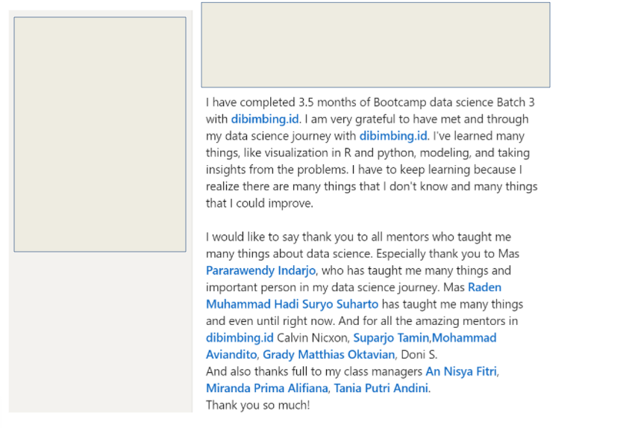
Aspect 3 : LinkedIn - What NOT to Do

Slide 20
Aspect 4 : Uniqueness, Completeness
This is up to you.
The freedom is yours.
A complete project would look like this:
You get the data on your own (web-scraping, etc)
You upload the data somewhere (so people can also validate your project if they want to)
You clean the data, do exploration, draw visualization
You create machine learning model, train, choose the best one
Then, you deploy the model in a web application so people can use it too!
Last but not least, you upload the project to github, write to medium, and share it on LinkedIn

Slide 21
Aspect 4 : Uniqueness, Completeness
But it’s time consuming.
But it is what gets me into my current company.
However, are there people who don’t do a complete project, but also get into tech companies? Sure, there are lots of them.
So it’s not a must.
It’s good if you do it. But it’s not a must.

Slide 22
Aspect 4 : Uniqueness, Completeness
Types of project:
In-depth data exploration
You get a big dataset, visualize, and get interesting insights from it, then create an aesthetically pleasing and informative report out of it. For example: Pande’s Bicycle Theft Report
Modelling
You get a dataset, clean it, preprocess it, and create a machine learning model out of it. The model can be used to predict new data. You validate that the model is good enough by calculating the accuracy score, etc. For example: my jakpartment project
Exploring an advanced topic
You study a unique and advanced topic, and report your findings. For example: https://vinson2233.netlify.app/posts/sklearn-vs-numpy-vs-numba-speed-comparison/

Slide 23
Aspect 4 : Uniqueness, Completeness
You can choose either one. But caution!
If you choose Type 1: make sure your analysis is REALLY IN-DEPTH. Your visualization is Good. If your conclusion is something obvious, like “Apartment with bigger area is more expensive”, your project is not interesting.
If you choose Type 2: make sure your modelling is UNIQUE, and you put your personal twist out of it. Make create your own feature engineering. Maybe tune your model some way. Maybe create two or more models and ensemble it.
If you choose Type 3: your topic must be INTERESTING and ADVANCED enough. Because if not, you’re not really exploring anything new.

Slide 24
How to Come Up with a Good Project Idea?
Get your dataset here:
kaggle.com
https://archive.ics.uci.edu/ml/datasets.php
Tools to deploy your project:
Heroku
Streamlit
Docker

Slide 25
Good Resources:
https://towardsdatascience.com/
https://machinelearningmastery.com/
your own curiosity, and Google :)

Slide 26
FAQ
Q : Apakah streamlit, heroku, docker, web-scraping diajarkan di bootcamp?
A : No. Mengapa? Karena sejatinya, semua itu bukanlah materi Data Science. Itu lebih ke web-development, programming, coding with Python. Lagipula, materi dan kurikulum kita sudah sangat padat.
Q : Kalau gitu belajarnya di mana?
A : Google and Youtube. Semuanya gratis, dan lengkap :)

Slide 27
Q&A

